Slide 1
Arcryptix Cybersecurity Consulting
Neel Patel, Amaanullah Shahim
Cybersecurity Consulting – CSCE 4560.002
Group 10

Slide 2

Introduction - Overview
This project showcases our group’s development of a cybersecurity consulting business, named Arcryptix. Our business is geared towards start up companies and small business who are often underserved and not able to work with enterprise-grade security providers that typically cost a premium.
Our goal is to provide businesses an accessible and strong team of engineers that will utilize enterprise-grade security tools and offer services such as vulnerability assessment, penetration testing, and open-source intelligence services for our clients.
Arcryptix is designed with affordability and data privacy in mind while simultaneously providing authenticity and transparency with our clients.
Arcryptix represents a resourceful approach to cybersecurity, ensuring that anyone who uses our products has access to quality services.

Slide 3

Introduction - Problems Arcryptix addresses
A multitude of the security services available on the market today are designed for large enterprise companies which require a substantial investment into proprietary software, large teams, and tools, which just isn’t accessible to many other businesses who don’t have the same amount of funding as a large company.
Other small businesses, freelancers, startups face threats just as other business and require strong security services that will protect their assets against bad actors.
Arcryptix takes out the bloat in enterprise security and distills what works. We simplify the process, utilizing tools that are effective and reliable that bring real results and secure infrastructure for our clients.
We believe that the highest security is deserved and should be accessible, understandable, and useful, even if budgets are tight and teams are small.

Slide 4
Project Structure and Design
Client (Frontend)
The Arcryptix frontend includes the user's web browser where they access the homepage, view products, and download tools. The frontend is developed and hosted using WordPress and Infinity Free. Our website is styled using the Woostify theme for a sleek and user-friendly interface.
Web Server (Infinity Free)
The server processes HTTPS requests from the client because we have our SSL certificate registered and verified to use on Arcryptix. It manages page routing, file downloads, and cart/checkout functionality. Though lightweight, the server also handles basic form processing and user management securely.
Database (cPanel MySQL)
User data, product listings, and site configurations are stored in a MySQL database. The database is accessed by the server whenever login authentication, cart operations, or product loading is required by our website.

Slide 5
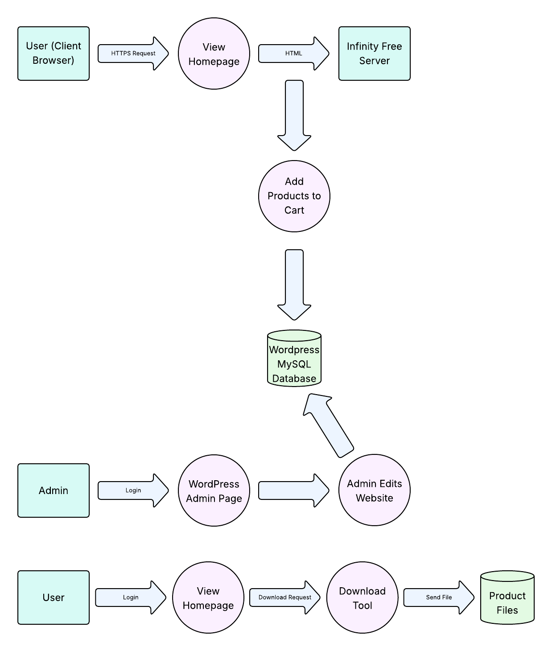
Project Structure and Design
Our Data Flow Diagram (DFD) to the right illustrates Arcryptix’s logical flow in three different states that span from user input and request travel to the website’s backend infrastructure. Though simple, the diagram is scalable and represents how our site functions in a straightforward manner.

Slide 6
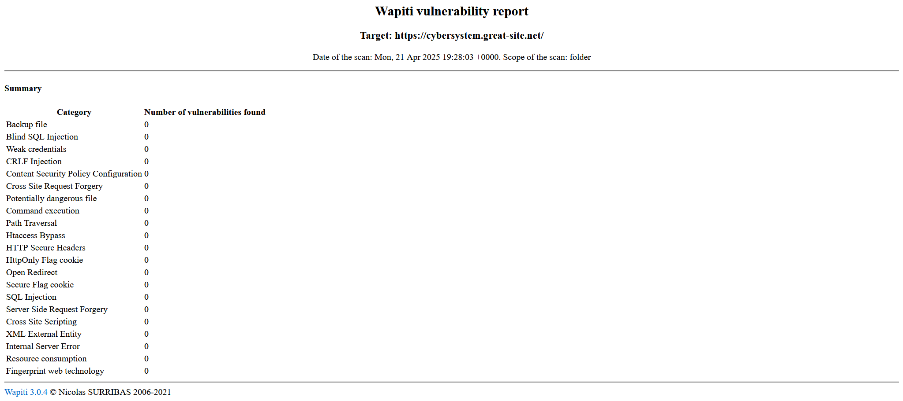
Results and Analysis - Wapiti

Slide 7
Results and Analysis – Wapiti Cont.
With our Wapiti scan, our group confirmed that we have vulnerable to 0 threats scanned and our website doesn’t expose any known vulnerabilities in Wapiti. From here, we have concluded that Arcryptix is safe from:
Malicious URL Injections
Cookie & Session Data Tampering
Sensitive Information Leakage Through Misconfiguration
Cross-Site Scripting & Redirect Exploits
Unauthorized Access via Insecure Endpoints
To assess Arcryptix’s security as a deployed web application, we utilized Wapiti, which is an open-source web vulnerability scanner. Wapiti can scan for, but isn’t limited to:
SQL Injection (including Blind SQLi)
Cross-Site Scripting (XSS)
Command Injection
Path Traversal
Weak or Missing Secure Headers
Backup File Exposure
When we ran our Wapiti scan on our live site of our web site (https://cybersystem.great-site.net), we were amazed at what it found. The scanner gave a wide sweep of common web attacks like SQL injection probes, cross-site scripting (XSS), command injections, weak passwords, and even insecure cookies and misconfigured headers probing.
In brief, it tried to make holes into our architecture on our site from different points, backend, frontend, and network level, and check whether it can access the system without authorization, disclose sensitive files, or fool the system to dump information. This is a very aggressive test, especially when you're releasing a web-based product into the public view, because vulnerability in this type of area is exactly what hackers try to capitalize on. We didn't see any vulnerabilities, and that just great news. That is, all to ensure we're safe: our inputs are likely being cleaned properly, our cookies aren't leaking information, and we're not having open entry points or files exposed. Now, of course, we're on a free host, and we're just starting out, so this shows that we did take the time to construct with security in mind at least initially.
This scan does not catch everything, i.e., business logic flaws or things that only appear with larger human testing, but good to know that our foundation security posture is okay. It's also validation that tools such as Wapiti are worth it for startups or small teams that must validate their work prior to shipping to production.

Slide 8
Conclusion
The development team focused on building Arcryptix through deliberate choices because their mission centered on offering trustworthy practical cybersecurity tools to users of all levels of expertise. The core purpose was to build an operational platform which upholds security principles and applies ethical design approach. The Arcryptix platform development involved creating an intuitive design along with secured downloading capabilities alongside flexible system architecture. The entire project development process focused on designing both user-friendly interfaces and resilient platform infrastructure through every decision made. Security testing showed our dedication to maintaining ethical standards in development practices. Through the Wapiti security scanner, we investigated our website for standard and dangerous security weaknesses such as SQL injection attacks as well as cross-site scripting (XSS) and command execution, and unsecured cookies.
The results were reassuring: All vulnerability tests on different categories returned completely empty results. The security of our configuration becomes stronger by these results which validate our thorough approach to development. Arcryptix serves as an essential platform beyond its functions as website since it acts as the base that leads users toward advanced cybersecurity skills. The platform unites educational resources with tools and open transparency which operates through a safe professional environment. Our team feels a strong sense of pride in the creation we have accomplished while showing intense enthusiasm toward its future expansion potential.

Slide 9
References
Wapiti
https://github.com/wapiti-scanner/wapiti
Infinity Free
https://www.infinityfree.net/
HTML/CSS
https://developer.mozilla.org/

